Slide 1
Recovery and Resiliency Funding
When Mother Nature Goes Elsewhere

Slide 2
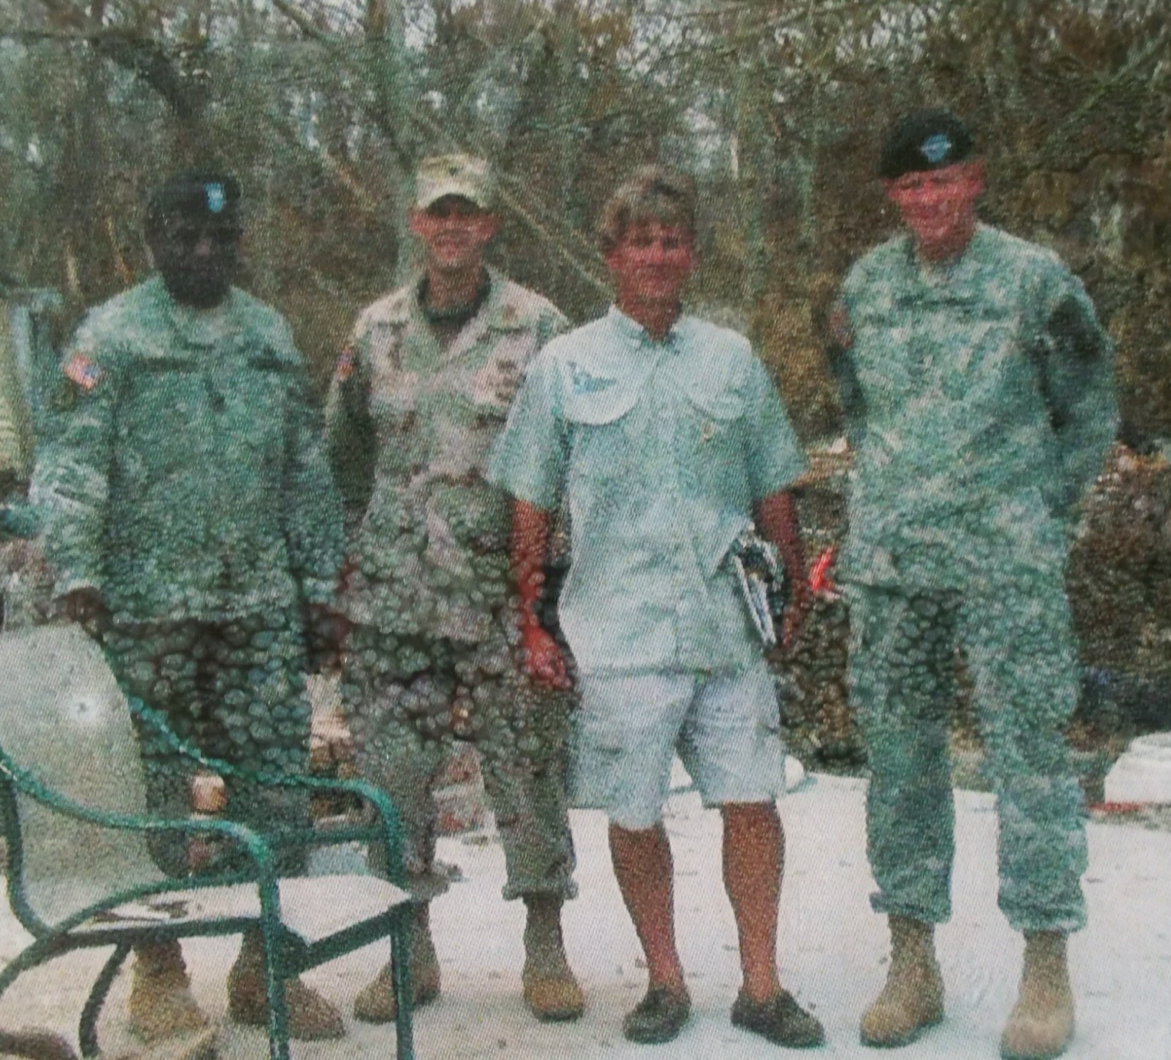
Presentation Outline
Introductions
Resiliency Continuum
FEMA versus HUD/CDBG-DR Processes
Funding
FEMA – Pre and Post Event Funding
Pre-event Funding
Hazard Mitigation 404 and 406
FEMA 428 Program
HUD/CDBG-DR Funds
Other Funding Source – FHWA, USACE, Etc.
Current Funding Status for South Florida
Case Studies
Post Event Resiliency Examples
Munster WWTP Consolidation
Questions

Slide 3
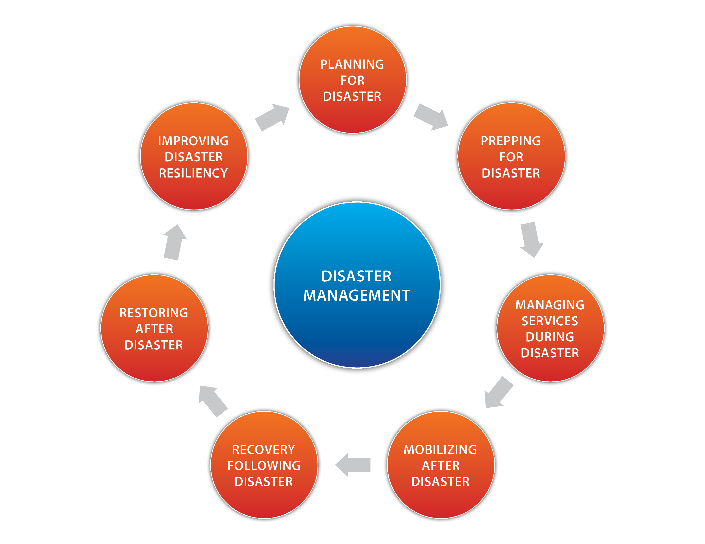
Resiliency Continuum
“A Vision without Resources is an Hallucination.”
̶̶ Thomas L. Friedman
Lessening the impacts of the next one

Slide 4
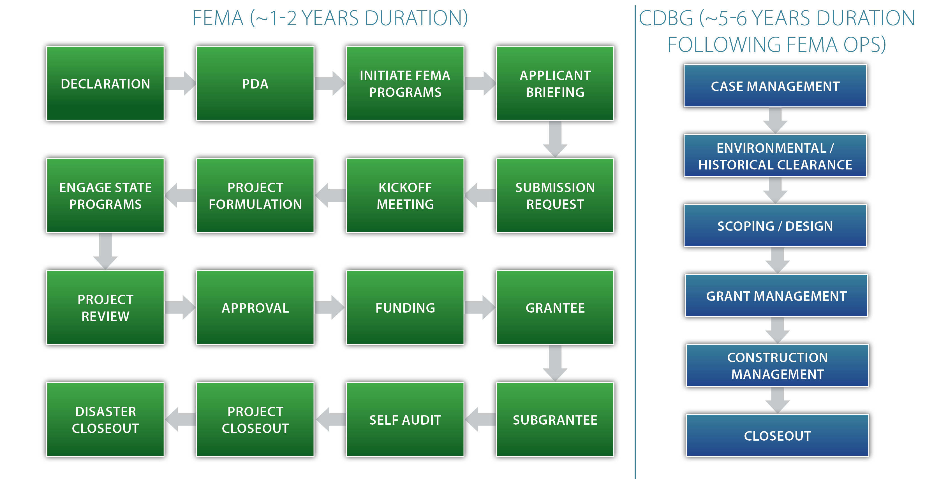
FEMA vs. CDBG Processes

Slide 5


FEMA vs. CDBG-DR Processes – Critical Differences
CDBG-DR
Typically performs NEPA Environmental Review for Applicant
Does NOT require Davis Bacon Compliance
Requires Competitive Procurement per local requirements
Requires NEPA Compliance prior to Construction
Requires Davis Bacon Compliance
Requires Section 3 Compliance
Impacts Other Funding Sources – Matching Funds are required to meet CDBG rules

Slide 6
Funding Source v Duration-Project Type
Major Signatories to the National Response Plan:
FUNDING TYPE | Pre-Event | Post-Event | 1-2 yr Post Event | 2-6 yr Post Event | Utility Infrastructure | Buildings | Housing | Roads | Flood Control/Protection
Hazard Mitigation Planning | X
Severe Repetitive Loss | X | X
FEMA Public Assistance |  | X | X |  | X | X |  | X | X
406 Hazard Mitigation |  | X | X |  | X | X |  | X | X
404 Hazard Mitigation |  |  |  | X | X | X | X | X | X
CDBG-DR |  |  |  | X | X | X | X | X | X
FHWA |  |  | X |  |  |  |  | X
USACE | X |  |  | X |  |  |  |  | X
Dept of Agriculture
Dept of Commerce
Dept of Defense
Dept of Education
Dept of Energy
Dept of HHS
Dept of Homeland Security
Dept of Housing & Urban Development
Dept of the Interior
Dept of Justice
Dept of Labor
Dept of State
Dept of Transportation
Dept of the Treasury
Dept of Veterans Affairs
Director of National Intelligence
Environmental Protection Agency
FBI
Small Business Admin
Nuclear Regulatory Commission

Slide 7
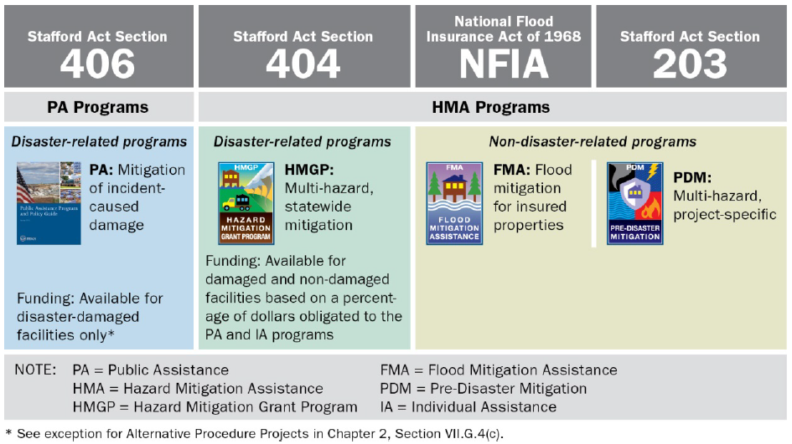
Why Plan Ahead?
Projects in Hazard Mitigation Plan
Better chance of 404 funding
Demonstrates Commitment to Hazard Mitigation
Know your hazard mitigation/ infrastructure rebuilding needs
Faster and better rebuilding decisions
Restore a severely damaged lift station?
Pursue temporary operation and replacement?
Better use of available funds
Can strategically position for CDBG-DR and Other Funds

Slide 8

Pre-Disaster Funding
Hazard Mitigation Planning Grants
Typically through the County
Updated Periodically
Can Include hazard mitigation needs for multiple entities – get your needs known
Severe Repetitive Loss Programs – Primarily Homes in Flood Prone Areas
Preparedness Grants

Slide 9
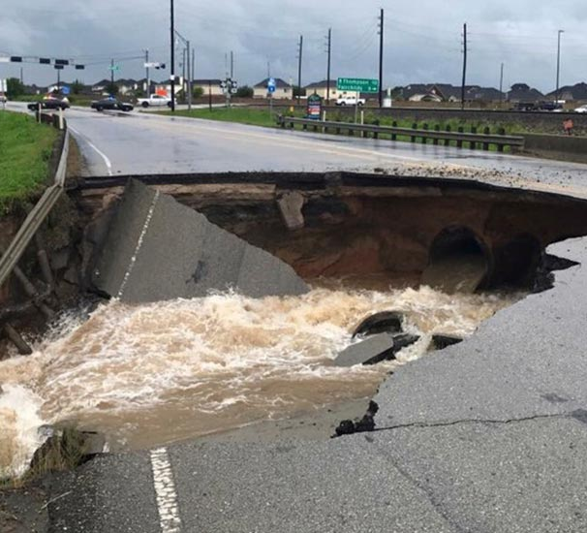
Post-Disaster Funding
FEMA Public Assistance Grants
Directly related to repair of damaged infrastructure
Can Apply Funding in Difference Manners
Repair in Kind
Pursue an Alternant Project
Pursue an Improved Project
Pursue FEMA’s 428 Pilot Program
Why Different Approaches
Combine Facilities?
Decommission Facilities?
Implement Something New?

Slide 10
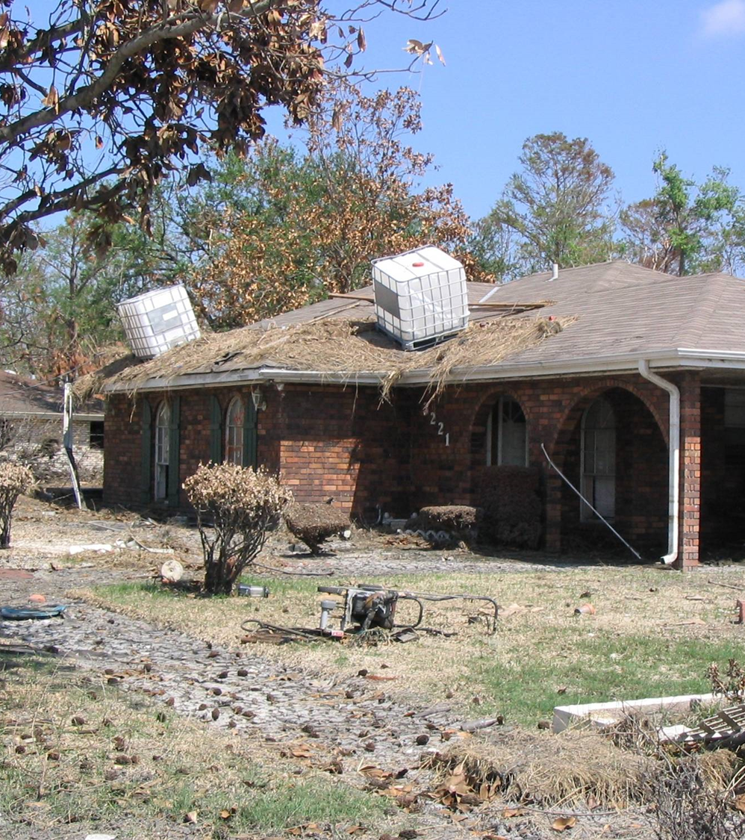
Post-Disaster Funding
FEMA 406 Hazard Mitigation
Directly related to mitigating damage to repair of damaged infrastructure
Additional 15% for non-critical infrastructure
Additional 100% or more for critical infrastructure
Examples
Raise damaged control panels
Convert to submersible pumps (dry pit or wet pit)
Change submerged pipe construction

Slide 11
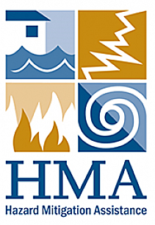
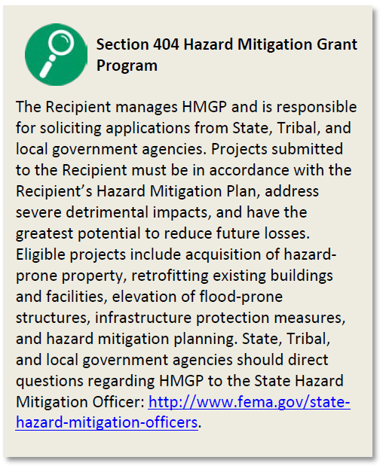
Post-Disaster Funding
FEMA 404 Hazard Mitigation
15% of Overall Damages to the State for an Event
Competitive Process
Typically available months after initial damage
Items not directly damaged by event.
Needs to be covered by Hazard Mitigation Plan
Examples
Relocation of critical infrastructure/buildings
Drainage system upgrades
Portable Pumping Equipment

Slide 12


Post-Disaster Funding
Other Funds
FHWA – federal aid roads – County road impacted by hurricane
USACE – levees, drainage, flood control – Minot, ND Flood Control Canal
Often defined in disaster funding authorization

Slide 13
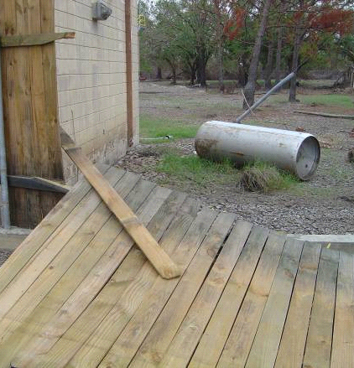
Post-Disaster Funding
CDBG Funds
Available if Congress authorizes funding
Spending constraints defined in authorization
Opportunities to influence spending constraints
Often requires unmet needs study after event
Examples
Any Items Input Into State Action Plan
Housing Buyout
New and Hardened Infrastructure
Ports, Etc.

Slide 14

Pulling it All Together – FEMA’s 428 Program
Method to combine repair projects (i.e., only restore 2 schools when 4 were damaged)
Capped cost estimate including hazard mitigation
Allows other funding sources (i.e., CDBG, 404, etc.)
Unspent funds can be utilized towards additional hazard mitigation

Slide 15
Current Funding Status for Florida* FEMA
Public Assistance
Hazard Mitigation Grant Program
Usually requires a 25% local match
Matthew: $314M; Irma: $228M
Matthew: $30M; Irma: $930M
Total Program (2018): $235M Total
Cap/Applicant: $37.4M
Expected # of Awards: 250
Application Deadline: 1/31/2019
Pre-Disaster Mitigation
Usually requires a 25% local match
www.FloridaDisastwer.org/Mitigation
*FEMA data through Aug 2018

Slide 16
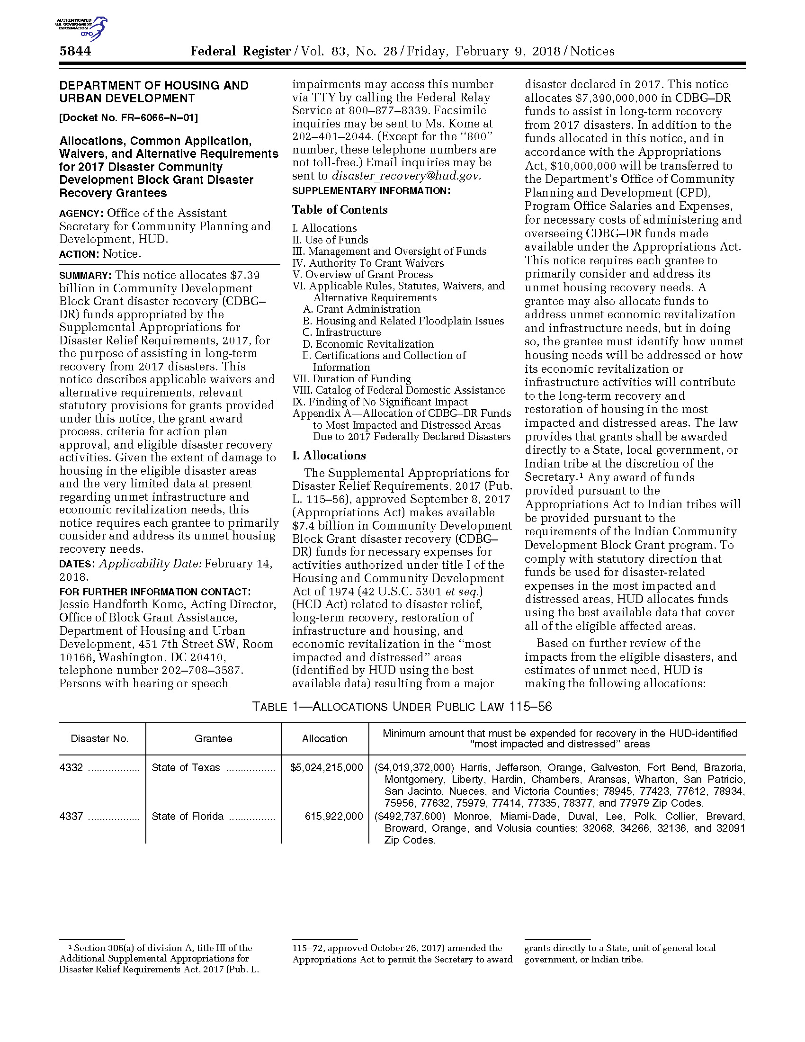
Current Funding Status for Florida CDBG-DR
Unmet Needs
In pursuit of ‘National Objectives’
Benefits LMI
Reduces Slums/Blight
Meets an Urgent Need
Can’t duplicate FEMA or USACE $
Process:
Federal Register identifies ‘strings’
State/Recipient Prepares Action Plan
County/Town (Sub-Recipient) signs Agreement

Slide 17
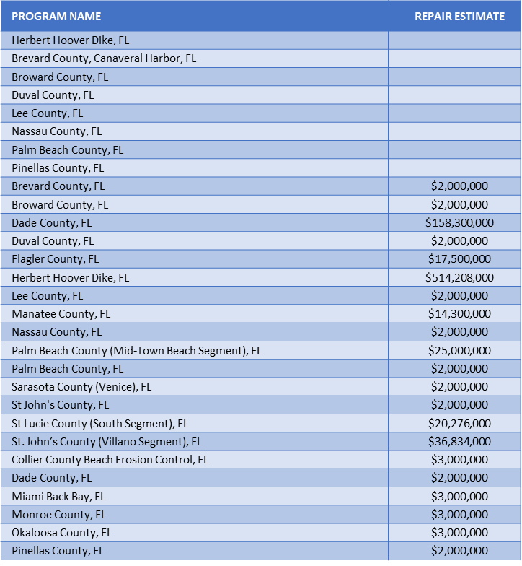
Current Funding Status for Florida USACE
Bipartisan Budget Act of 2018
PL 115-123, signed 2/9/18
~17B USACE-wide for Long Term
Disaster Recovery Projects & Short
Term Repairs
Executive Agent for Florida:
Jacksonville District (SAJ)

Slide 18
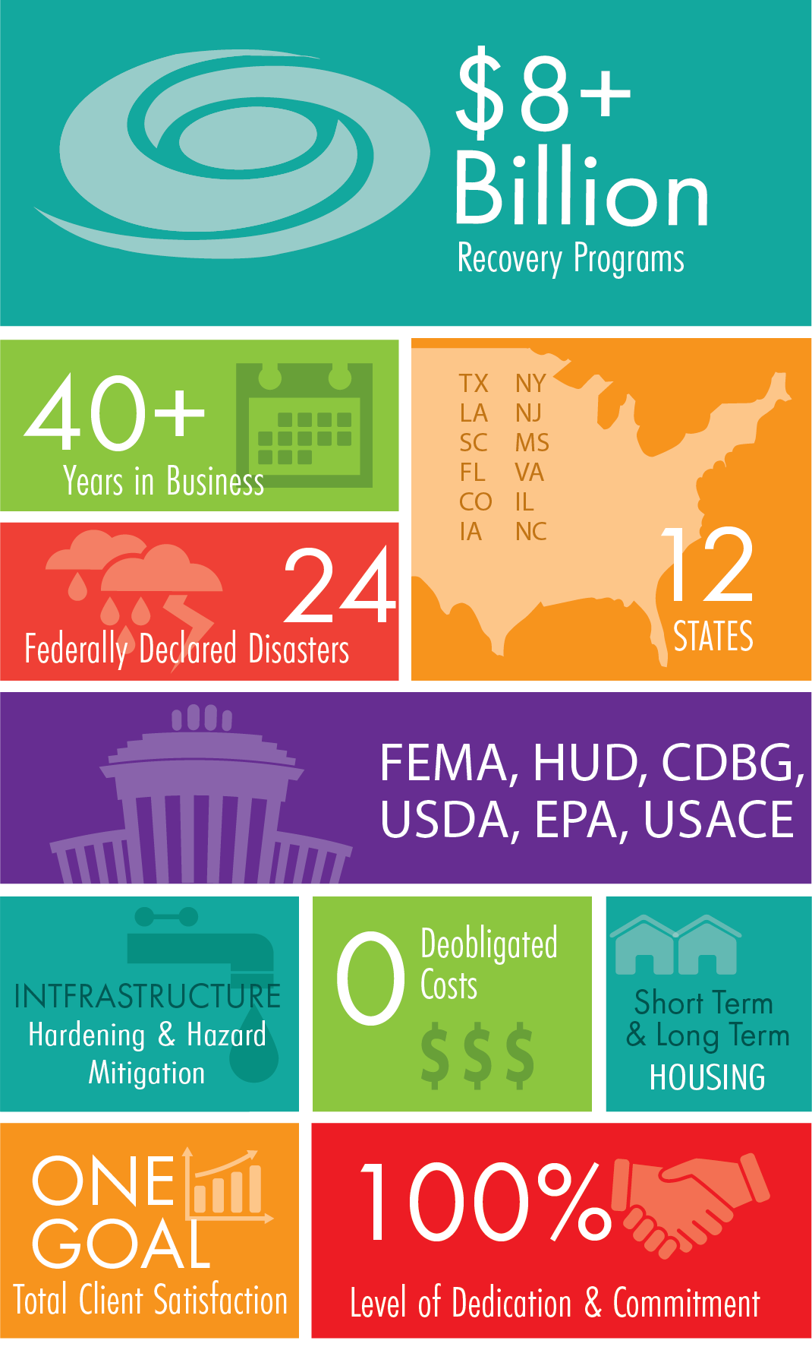
Case Studies: Ardurra Disaster Recovery By the Numbers

Slide 19
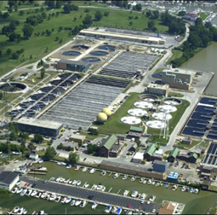
Nassau County, NY Bay Park Sewage Treatment Plant (Superstorm Sandy)
Funds
FEMA PAAP 428
CDBG-DR
EFC SMLP
Mitigation
FEMA PAAP 428
$64 M earthen/T-wall Berm with flood gates surrounding the entire plant
CDBG-DR
$101 M elevated Main Electrical Substation
EFC SMLP with CDBG-DR Match
~$30 M Pump Station and Force Main that feeds into the plant
Notes:
Insert picture from previously sent link

Slide 20
New Orleans (Hurricane Katrina)
Scope: major drainage canal & pump station improvements
Funding: USACE (MVN) + Cost Shared w/ Non-Federal Sponsors (Parishes)

Slide 21
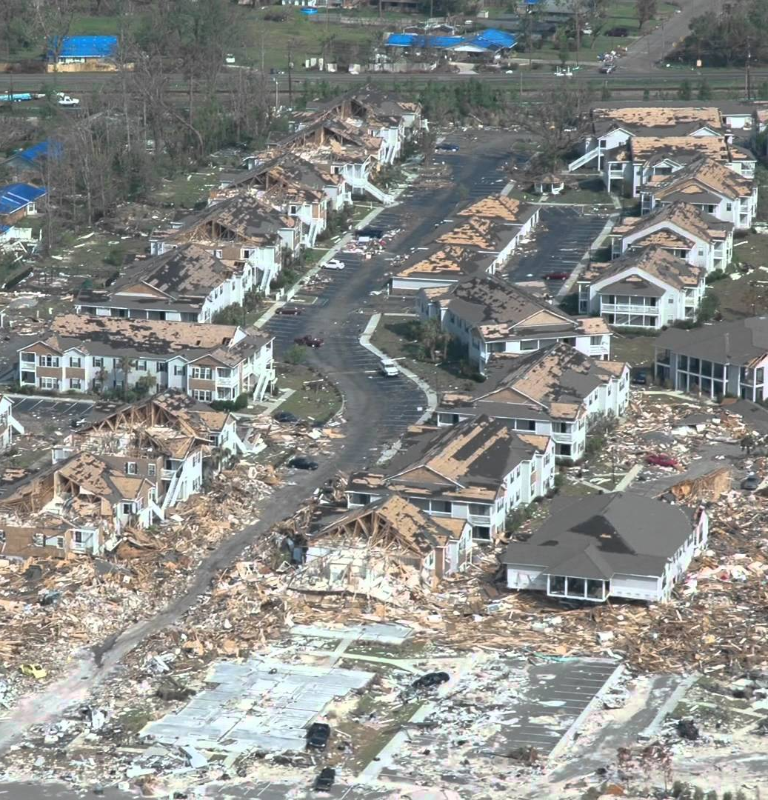
Mississippi Gulf Coast Water and Wastewater Master Plan (Hurricane Katrina)
$600 Million CDBG Funded Program
Five Coastal Mississippi Counties
Relocation and hardening water and wastewater facilities

Slide 22
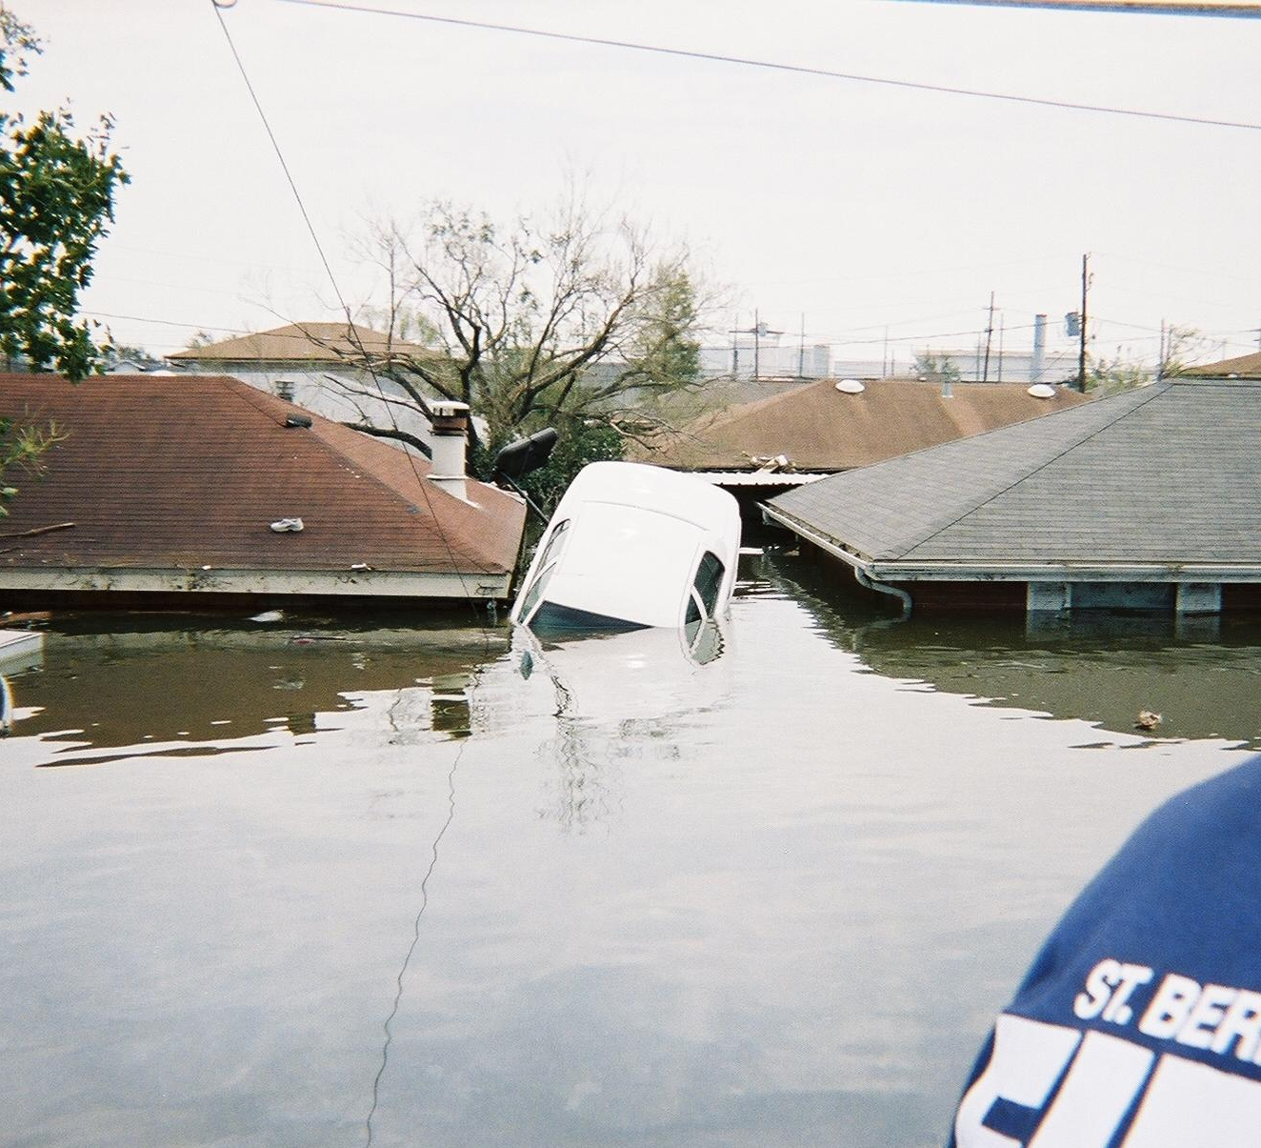
Overview of St. Bernard Parish
Pre-Katrina Population – 67,000
2012 Population – Approximately 35,000
Location – Southeast of New Orleans, Louisiana

Slide 23
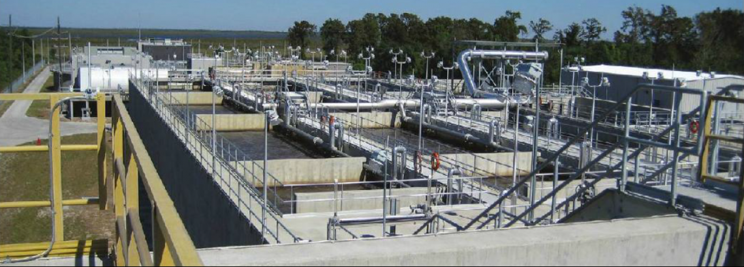
Drivers for Comprehensive Consolidation Approach
Consolidation Plan already in place pre-Katrina
Avoid repairs to two WWTPs slated for decommissioning
Ability to provide a comprehensively hardened system
Ability to reduce future emergency measures
Staffing and operating budget impacts

Slide 24
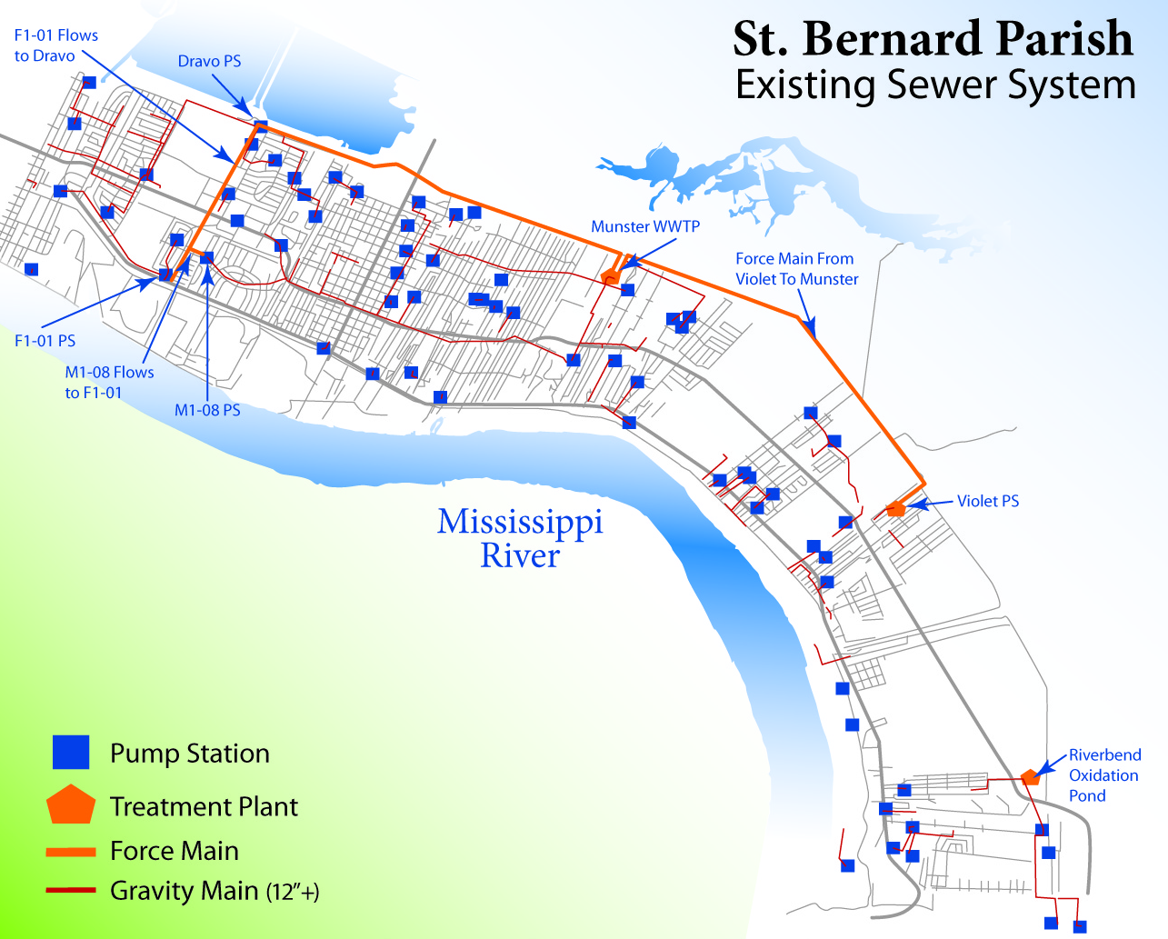
Post-Katrina Consolidation Approach

Slide 25
Components of Consolidation Approach
Fazendville WWTP Decommissioning
Hardening of F1-01 Pump Station
Dravo WWTP Decommissioning
Hardening and Reuse of Effluent Pump Station and Force Main
Violet WWTP Decommissioning
Hardening and Reuse of Influent Pump Station
New Force Main
New Force Main
Munster WWTP
Riverbend Oxidation Pond
Hardening
Expansion
Conversion to Wetlands Assimilation Discharge

Slide 26
First Funding Step – Define FEMA PA Funding
Cost to Repair
Fazendville
Dravo
Violet
Munster
Detailed Scope of Work and Cost Estimates
Prepare for Hard Negotiation ($11 - $26 Million)

Slide 27

Second Funding Step – Costs of Proposed Project
Establish Costs of Proposed Project
Expansion of Munster WWTP
Costs to Transfer flows to Munster WWTP
Develop Available 406 Hazard Mitigation Funds ($13 million additional funds)
Hardening Pump Stations at Violet, Dravo and F1-01
Repair critical components
Establish available funds for hardening Munster WWTP

Slide 28

Next Funding Step – Fill the Funding Gap
Determine the Funding Gap ($39 million to $66.5 million)
Identify Funds to Breach the Gap
CDBG Funds - $3 million for the Dravo PS
EDA Funds - $1 million for F1-01 Force Main Construction
404 Funds - $3.5 million for Munster Clarifier and Effluent Pump
Bond Issue - $20 million for the remaining

Slide 29
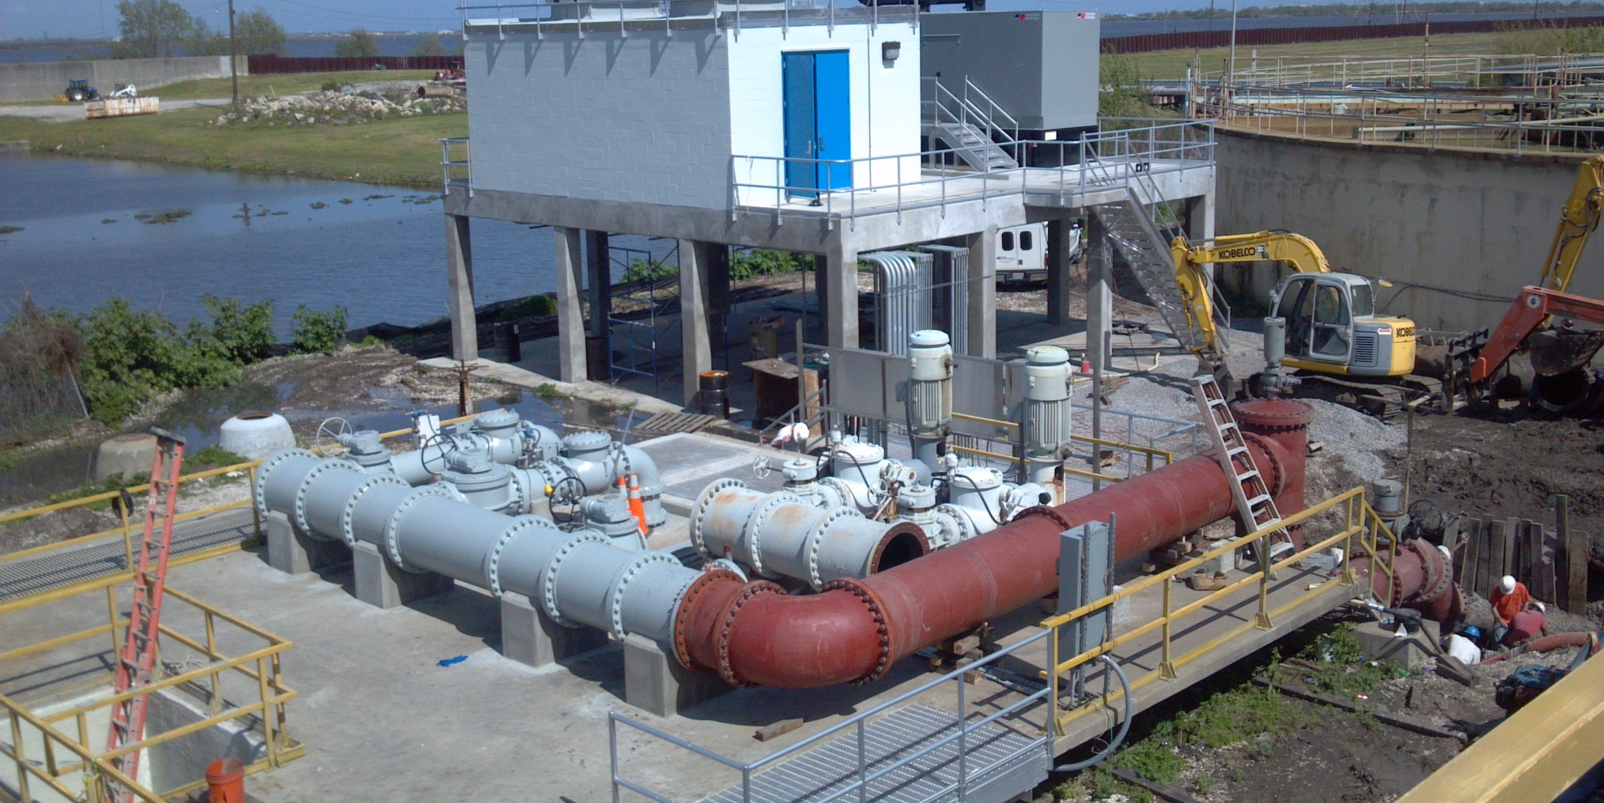
Dravo Pump Station

Slide 30
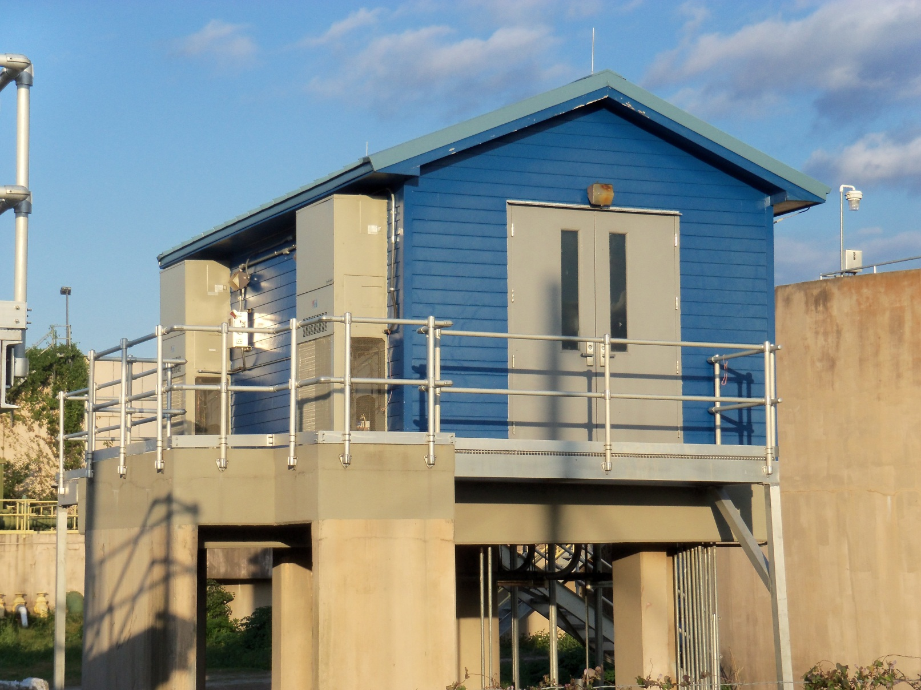
Violet Pump Station

Slide 31
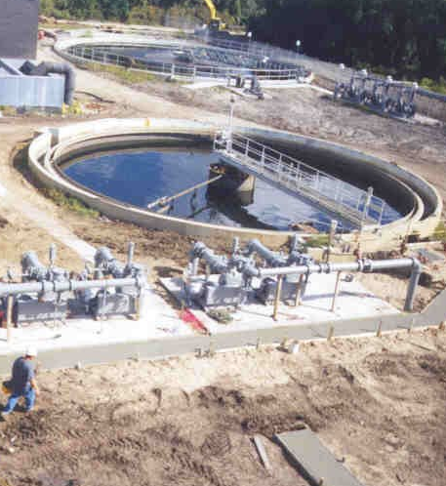
Munster WWTP Expansion – Highlights
Comprehensive Mitigation of Entire Facility
Capacity Expansion to Accommodate Decommissioned Facilities
Extensive Emergency Generation Capabilities
Innovative Treatment Process to Increase Resiliency and Minimize Capital Costs
Elimination of Future Chlorine/Chemical Hazards

Slide 32
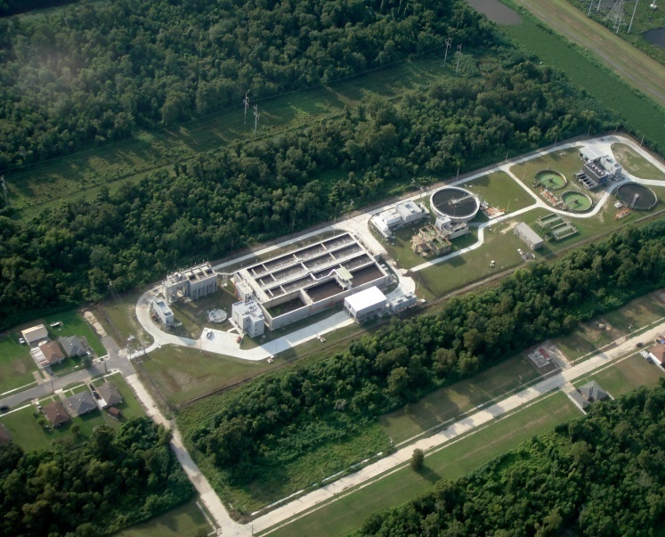
Munster WWTP
Plan Ahead
Know your path forward when funding becomes available
Be able to position for future funding (CDBG, etc.)

Slide 33
Questions?

Slide 34
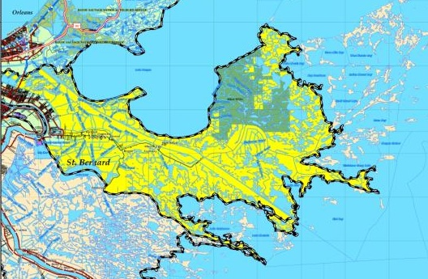
Fazendville Decommissioning (F1-01 Pump Station)
Raised Control Panels
Reused Existing Dry Pit
Conversion to Dry Pit Submersible Pumps
Force Main to Dravo Effluent Pump Station
Future Ability to Monitor from Munster WWTP (SCADA)

Slide 35
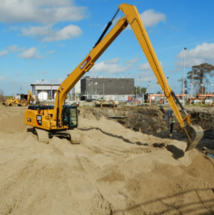
Dravo Decommissioning
Elevated Electrical/Control Building
Elevated Emergency Generator
Reuse of Existing Effluent Pump Station
Conversion to Submersible Pumps
Reuse of Existing Force Main from Dravo to Munster WWTP
Future Ability to Monitor from Munster WWTP (SCADA)

Slide 36
Violet Decommissioning
Elevated Electrical/Controls on Existing Structure
Elevated Emergency Generator on Existing Wet Well
Reuse of Existing Influent Pump Station
Conversion to Dry Pit Submersible Pumps
New Force Main from Violet to Munster WWTP
Future Ability to Monitor from Munster WWTP (SCADA)

Slide 37
Munster WWTP Process Flow Diagram

Slide 38
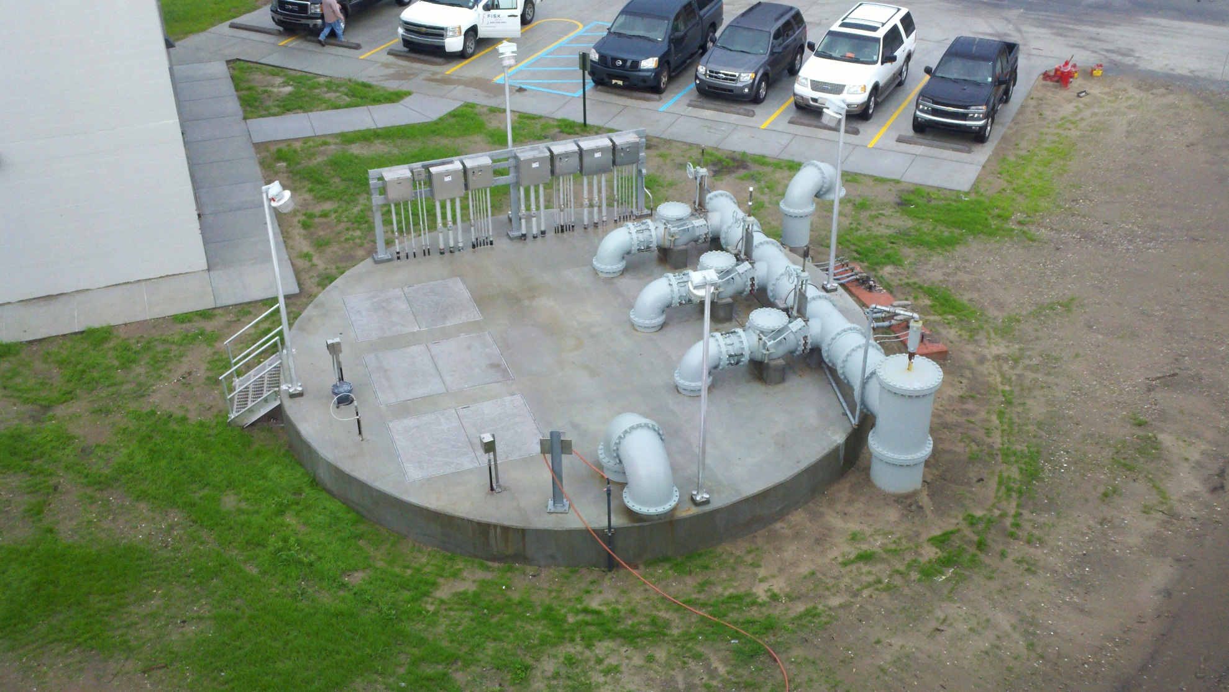
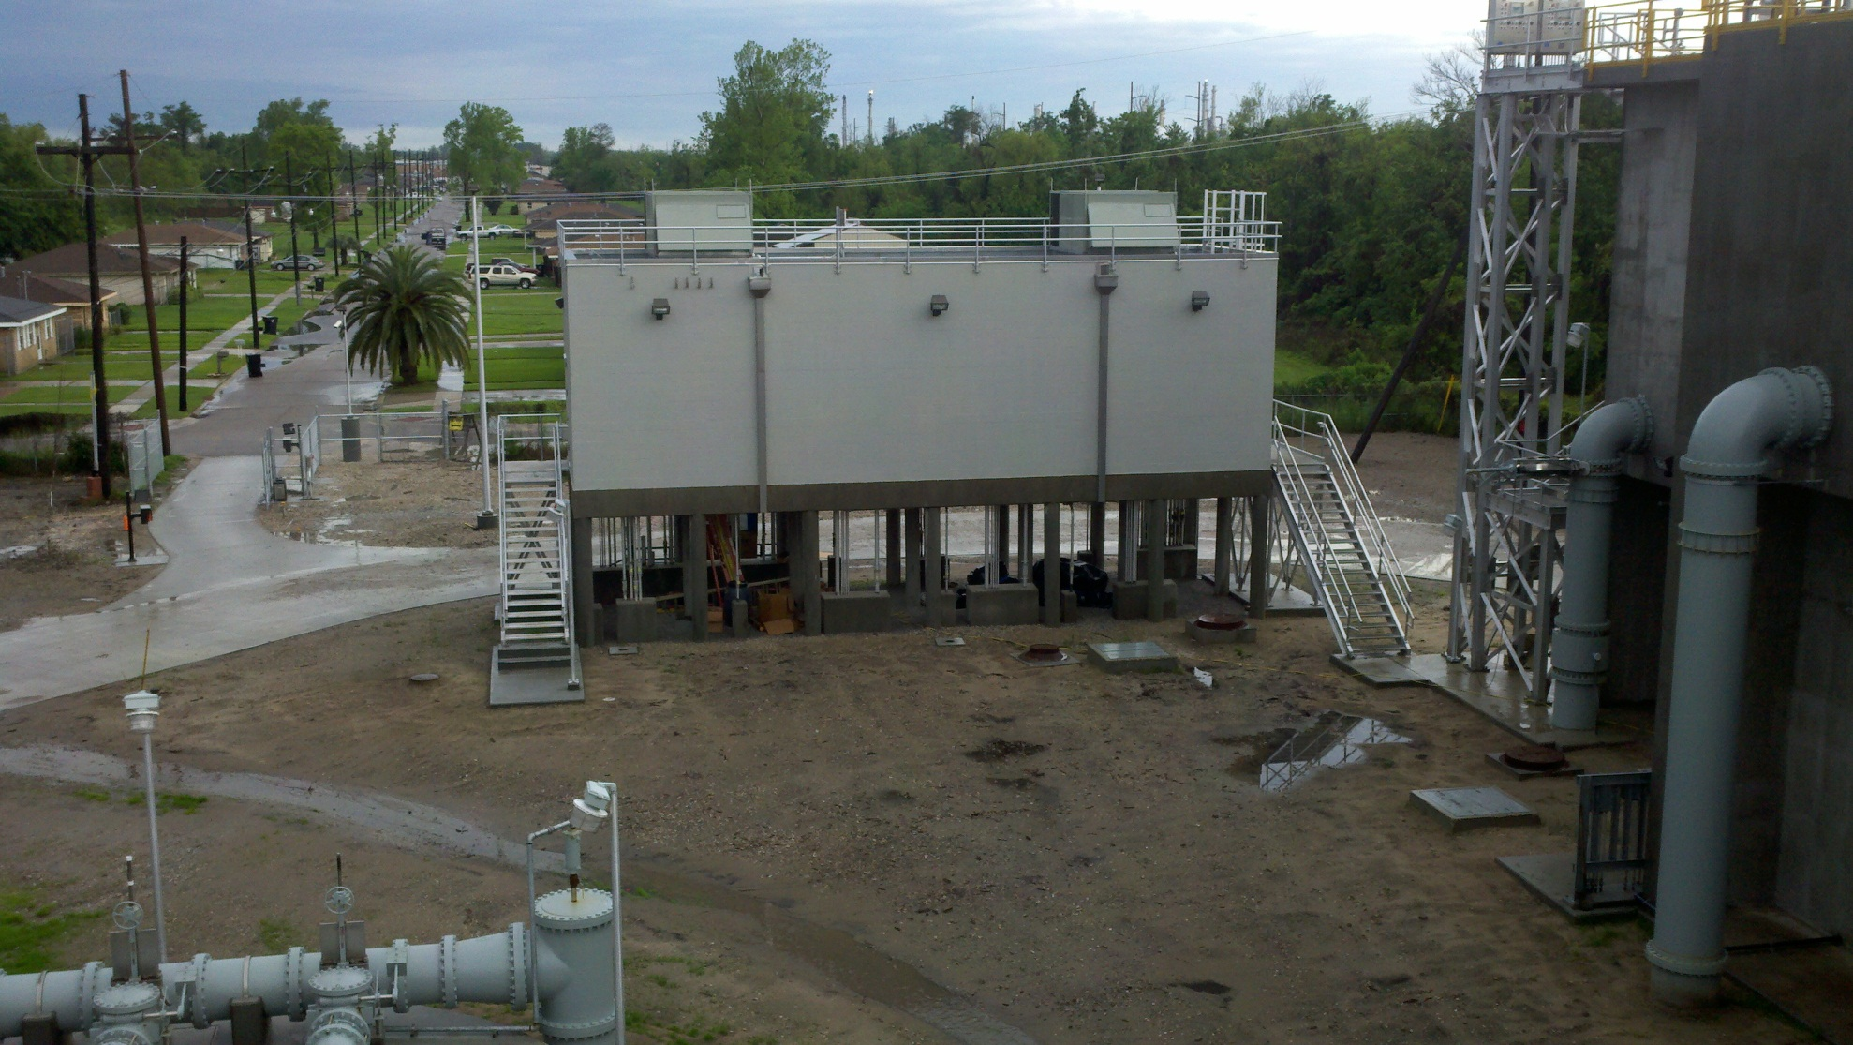
Influent Pump Station and Headworks
Influent Pump Station
Elevated Electrical/Control Building
Reuse of Existing Influent Pump Station
Conversion from VTSH Pumps to Submersible Pumps
Headworks
Elevated Electrical/Control Building

Slide 39
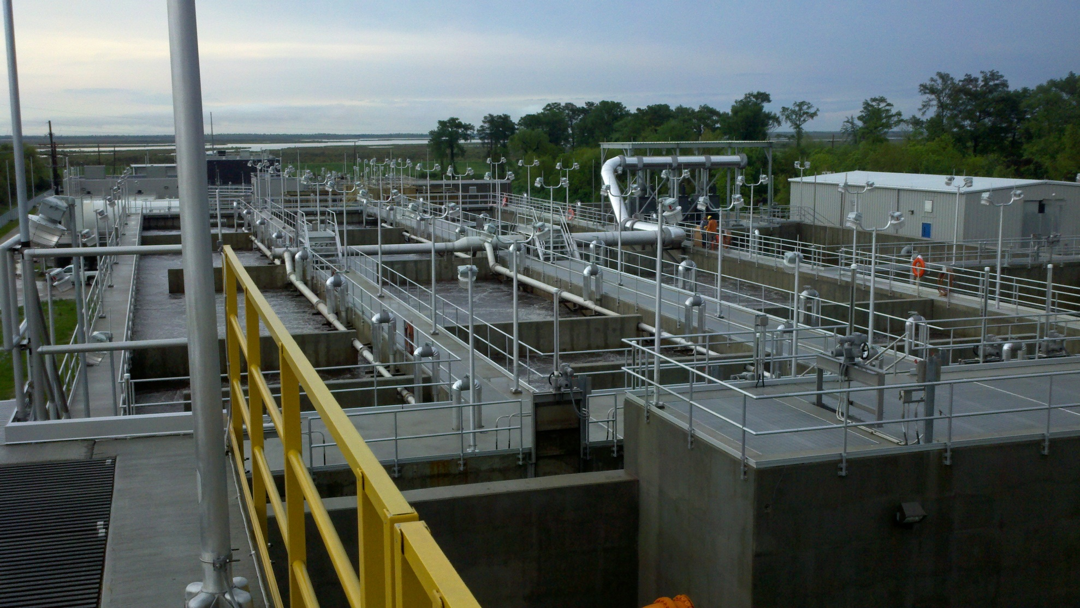
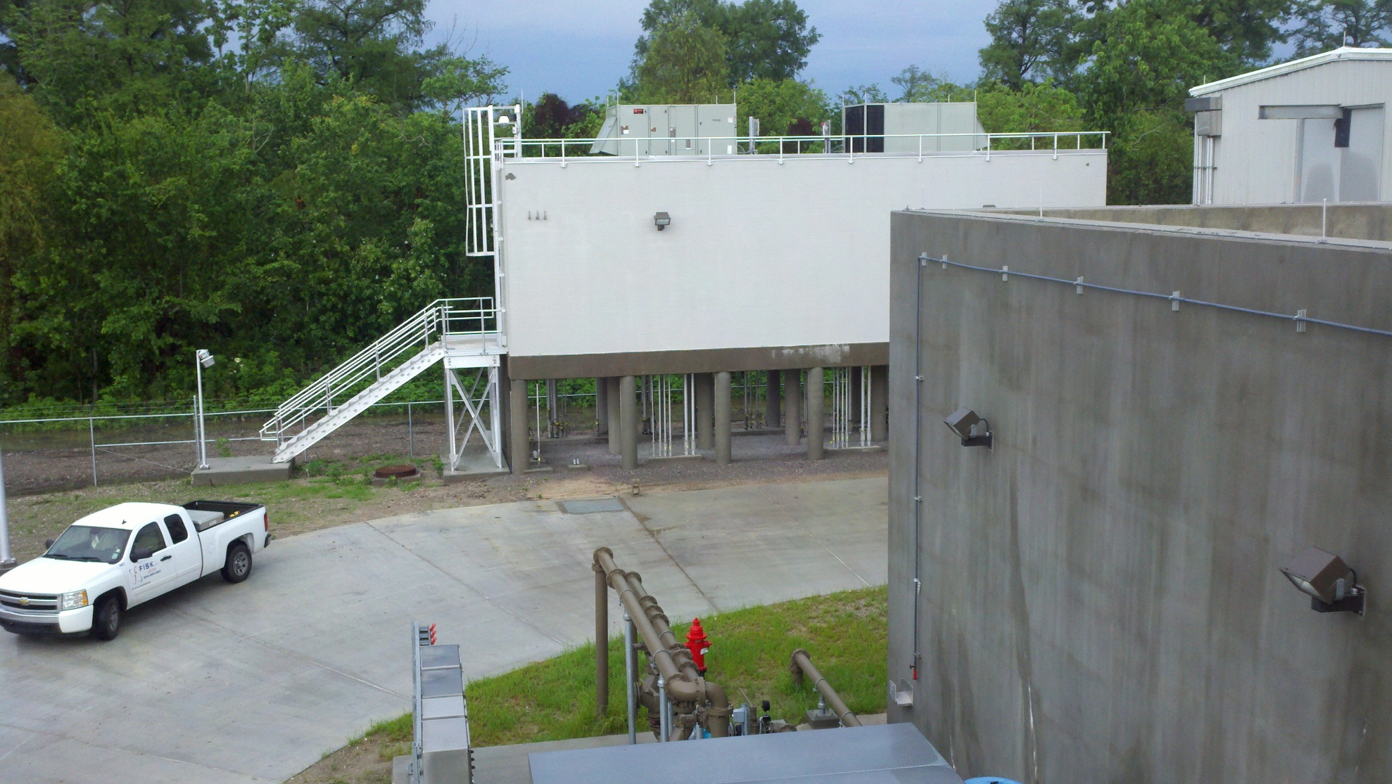
Aeration Basins and Digesters
Elevated Electrical/Control Building
Top of Structure Above Katrina Flood Elevation
Aeration Basin Blowers Located on Top of Structure

Slide 40
Effluent Pump Station
Elevated Electrical/Control Building
Reuse of Existing Effluent Pump Station
Conversion to Dry-Pit Submersible Pumps

Slide 41
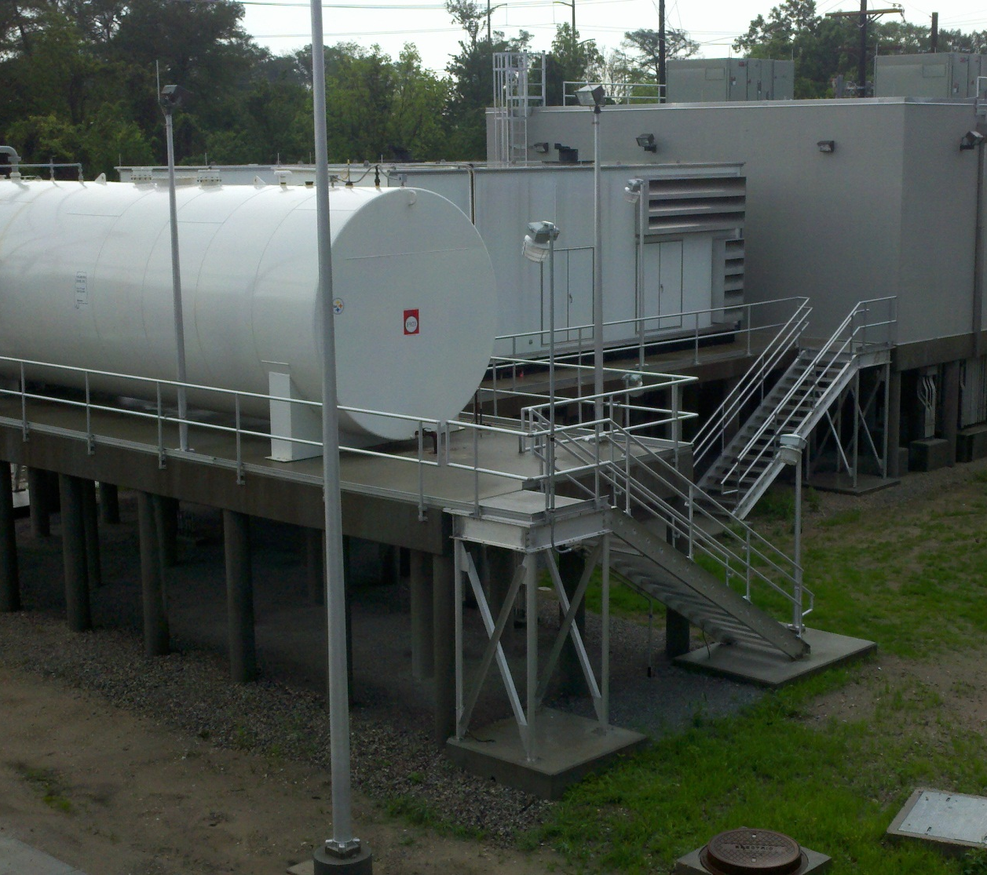
Electrical Feed and Emergency Generators
Elevated Main Electrical Building
Elevated Transformers
Elevated Generators and Fuel Storage
Two 2000 kW Generators
7 Days of Fuel Storage

Slide 42
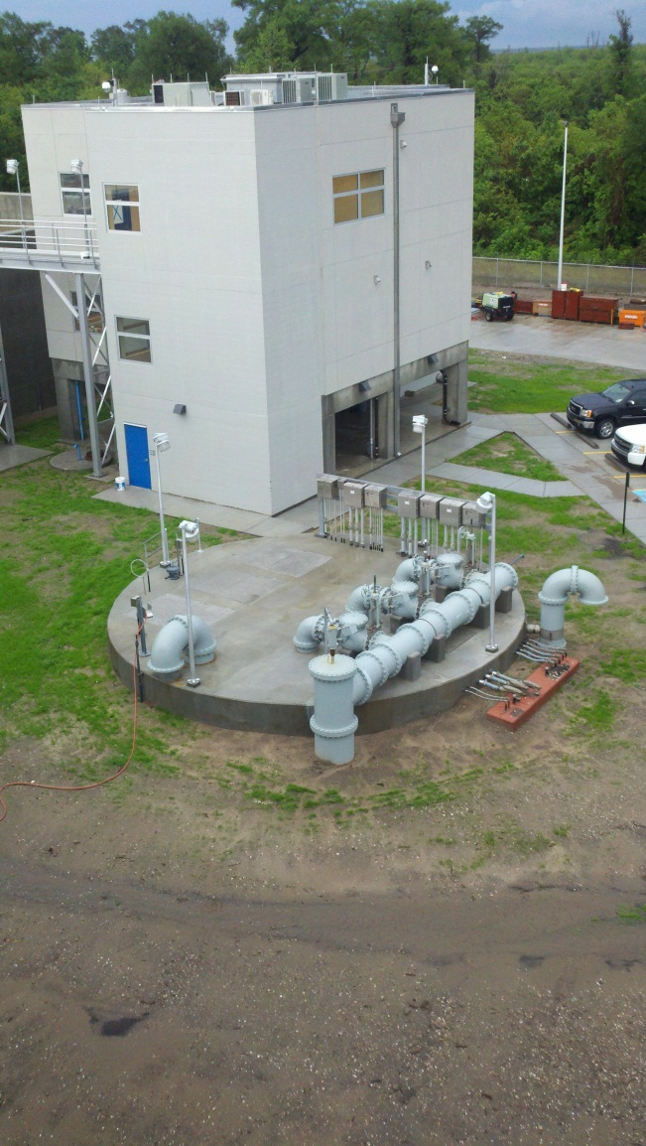
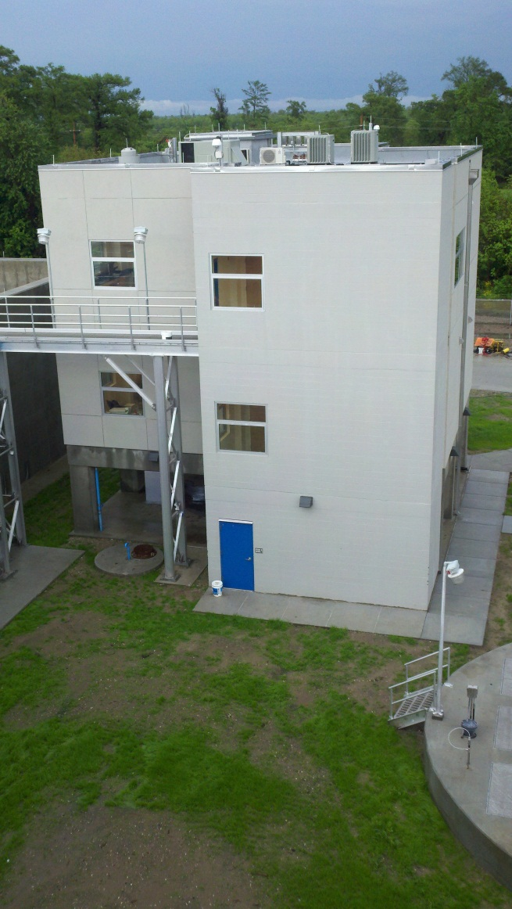
Administration Building
Comprehensive Hazard Mitigation at the Munster WWTP – St. Bernard Parish, Louisiana

Slide 43
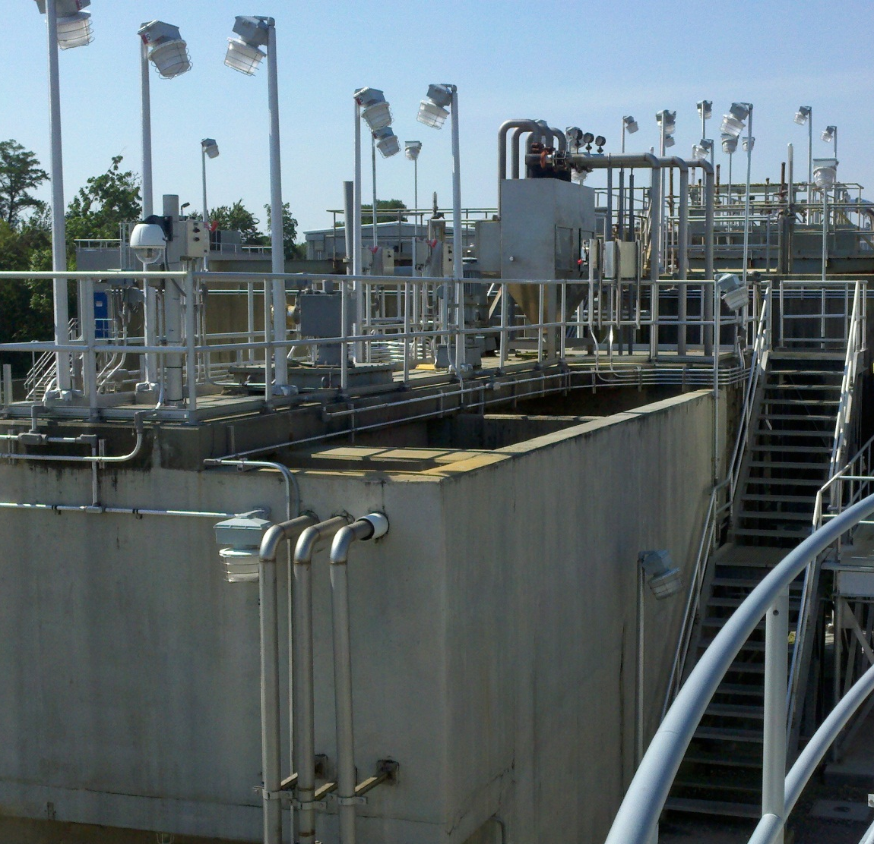
Munster WWTP – Biologically Enhanced HRC
Replaces 3.5 MGD of Dry Weather Capacity at Low Capital Cost (12 MGD Peak Capacity)
Provides High Level of Treatment at Low Horsepower
Limits Emergency Generator Needs and Fuel Consumption under Emergency Conditions
Limits Other Emergency Operation Needs

Slide 44
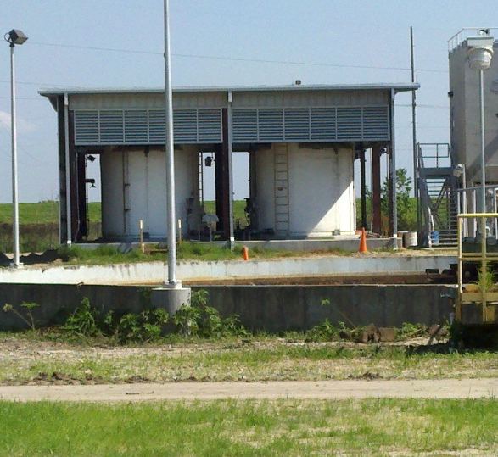
Munster WWTP – Chlorination
Converted from Gaseous Chlorine to Sodium Hypochlorite Disinfection
Eliminates chlorine gas hazards during normal operations
Eliminated dangerous gaseous releases during flood conditions
Simplifies hazard mitigation approach

